Slide 1




TECHNICAL UNIVERSITY OF SOFIA
FACULTY OF ECONOMICS
TECHNICAL UNIVERSITY OF SOFIA
ECONOMY FACULTY
Graduation thesis for the acquisition of an educational - qualification degree bachelor on topic:
“Analyzing customer behavior and clustering through machine learning "
Name: Kristina Braynova,
Speciality: “Management and Business Information Systems",

Slide 2

Content
1
Research question
2
Methodology
3
Exploratory Data Analysis
4
Machine Learning Model

Slide 3


Research question
Whether customer behavior is based on demographic factors and purchase history, how this information can be used to improve customer targeting and marketing strategies, and how cluster-based segmentation can be effectively applied to understand different customer segments ?

Slide 4


Methodology
Data Collection
Data Cleaning
Exploratory Data Analysis
RFM Analysis
Clustering through Маchine Learning

Slide 5

Attributs
Promotion
NumDealsPurchases;
AcceptedCmp1;
AcceptedCmp2;
AcceptedCmp3;
AcceptedCmp4;
AcceptedCmp5;
Response.
Clients
ID;
Year_Birth;
Education;
Marital_Status;
Income;
Kidhome;
Teenhome;
Dt_customer;
Recency;
Complain.
Products
MntWines;
MntFruits;
MntMeatProducts;
MntFishProducts;
MntSweetProducts;
MntGoldProds.
Place
NumWebPurchases;
NumCatalogPurchases;
NumStorePurchases;
NumWebVisitsMonth.

Slide 6


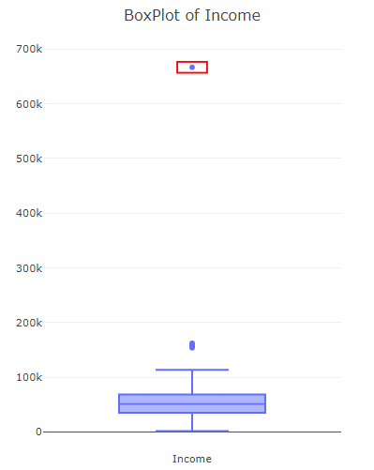
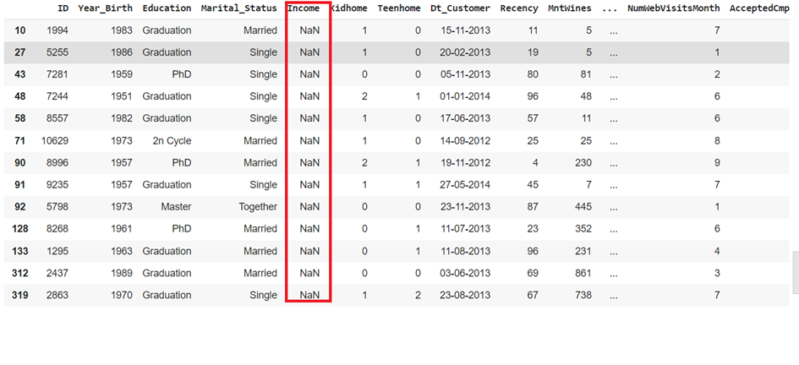
EDA
Data Cleaning

Slide 7
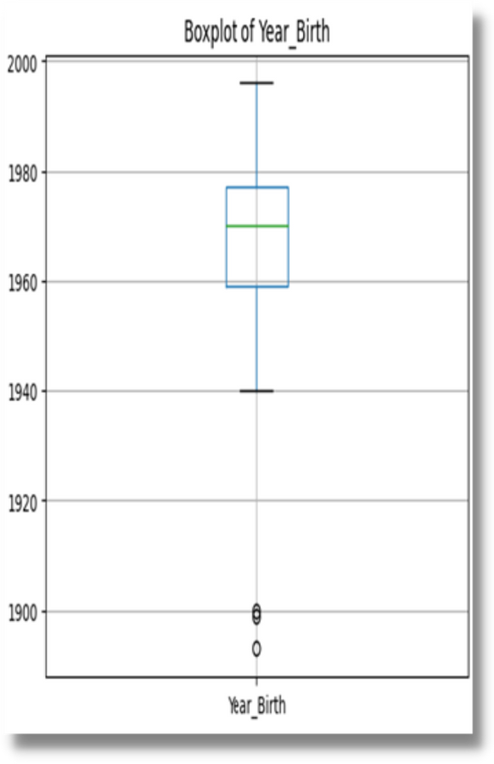
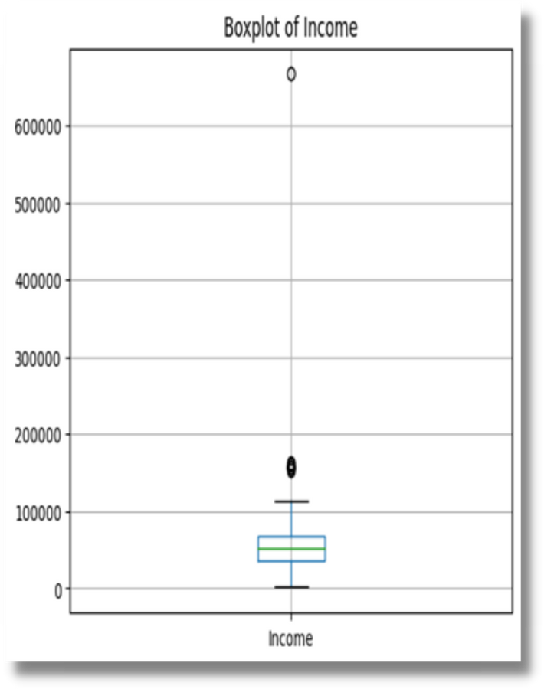

Outliers

Slide 8
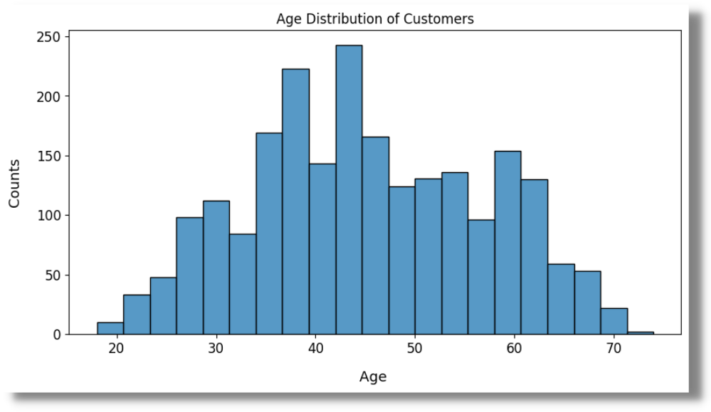
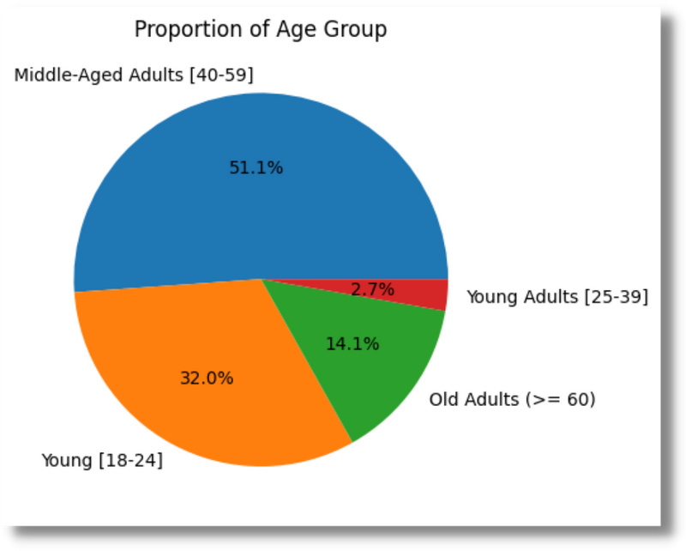
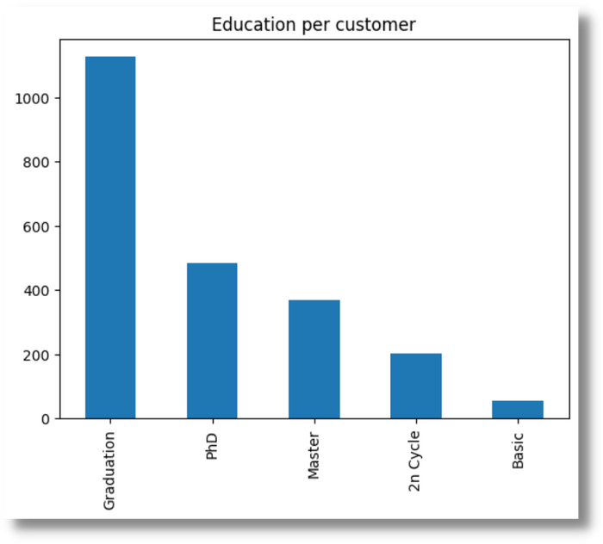
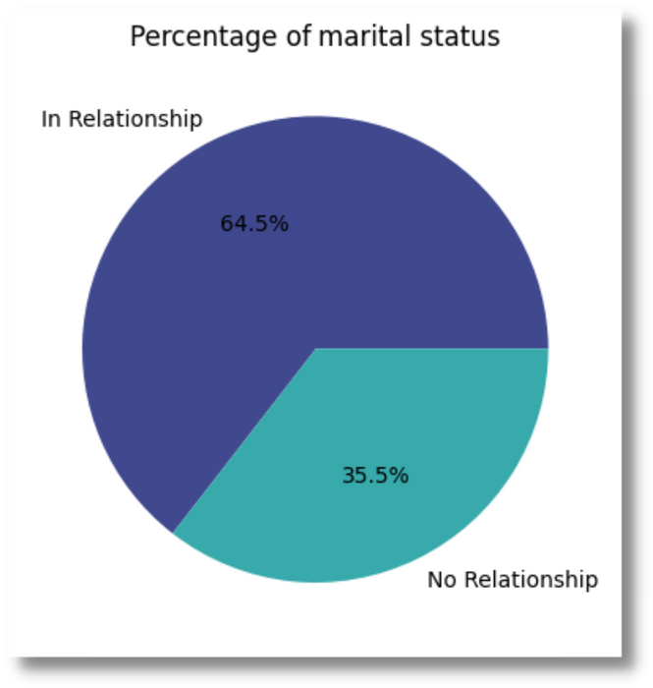
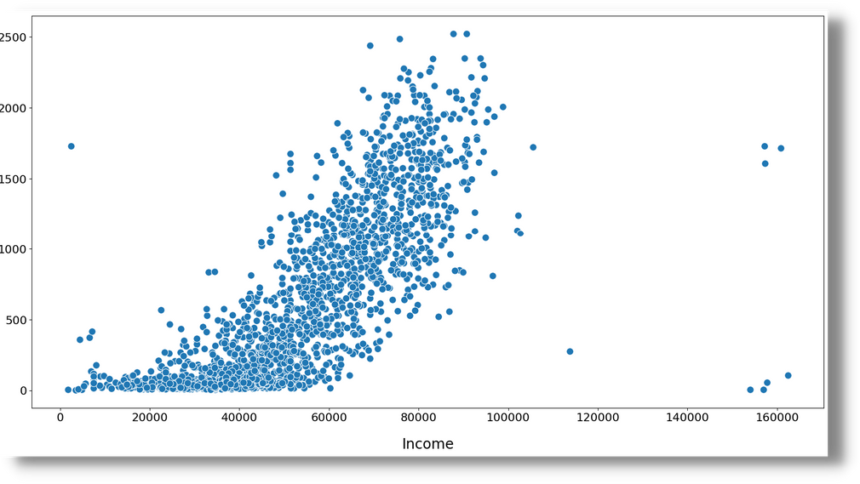

Slide 9
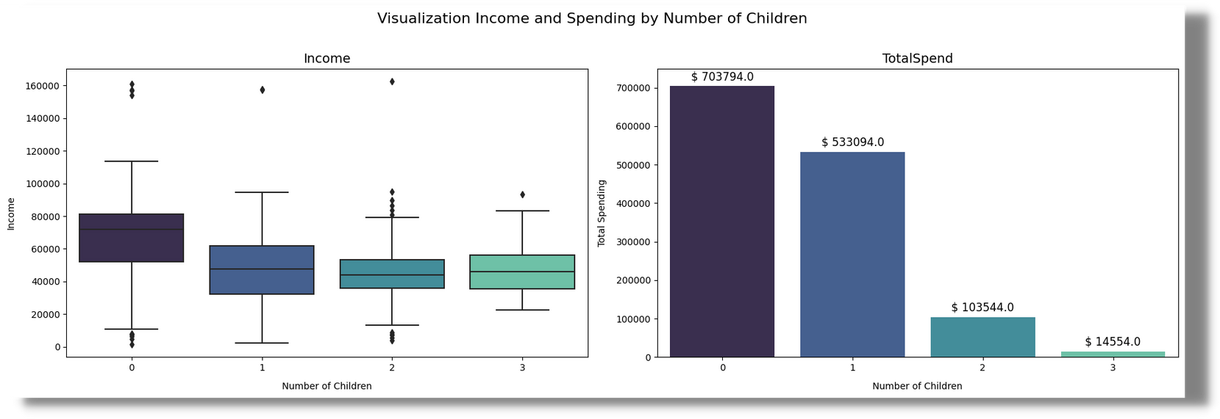
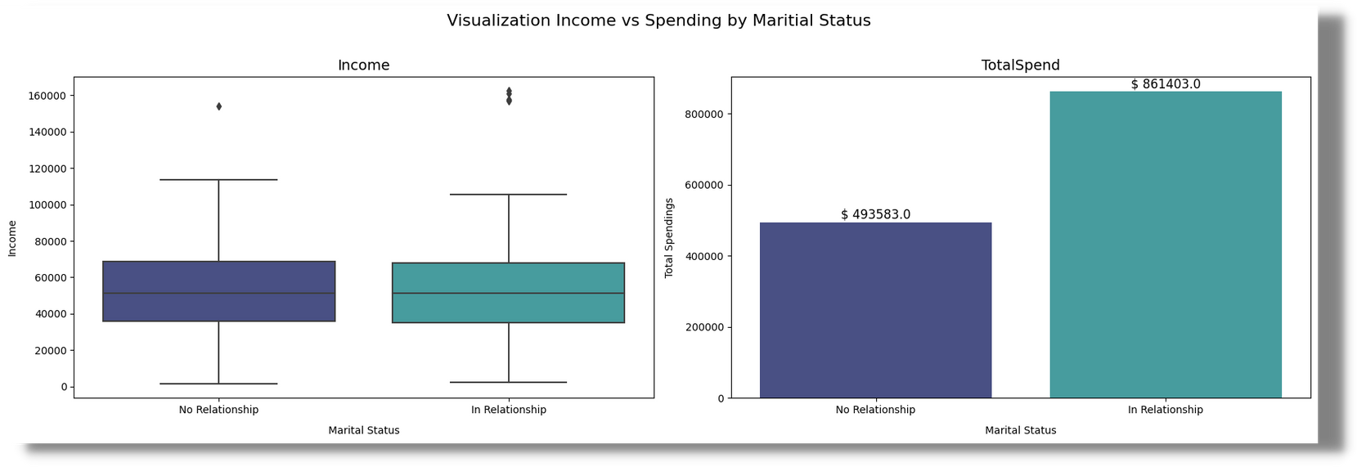

Slide 10
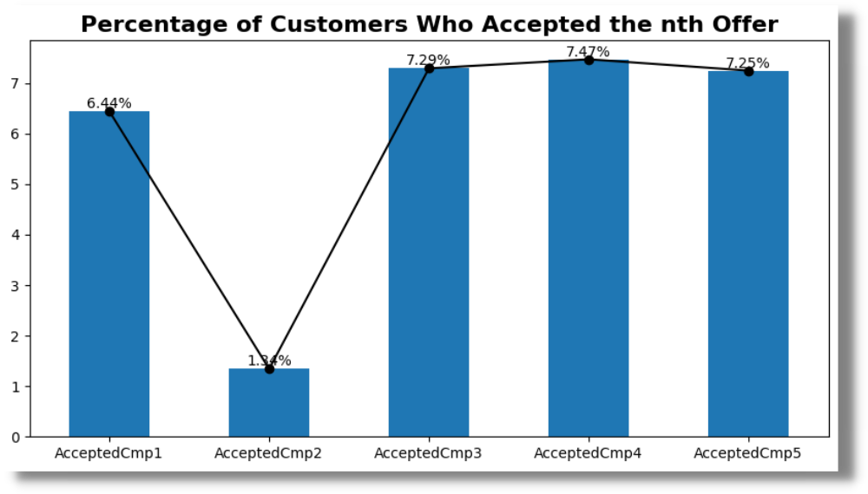
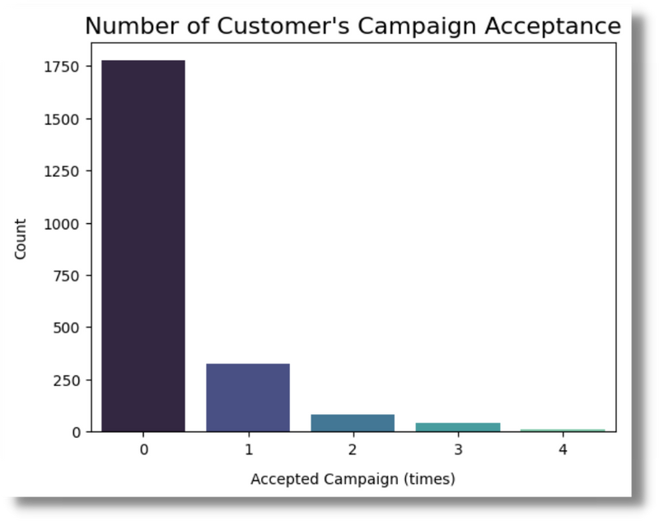
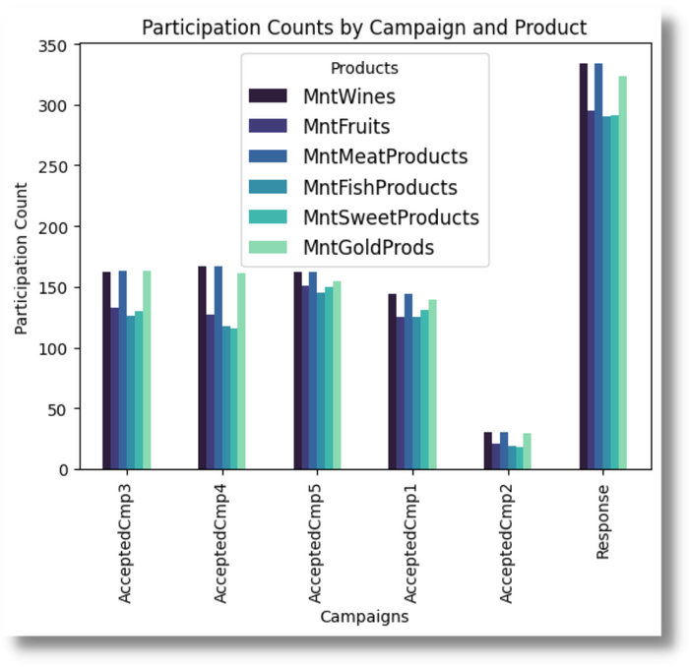
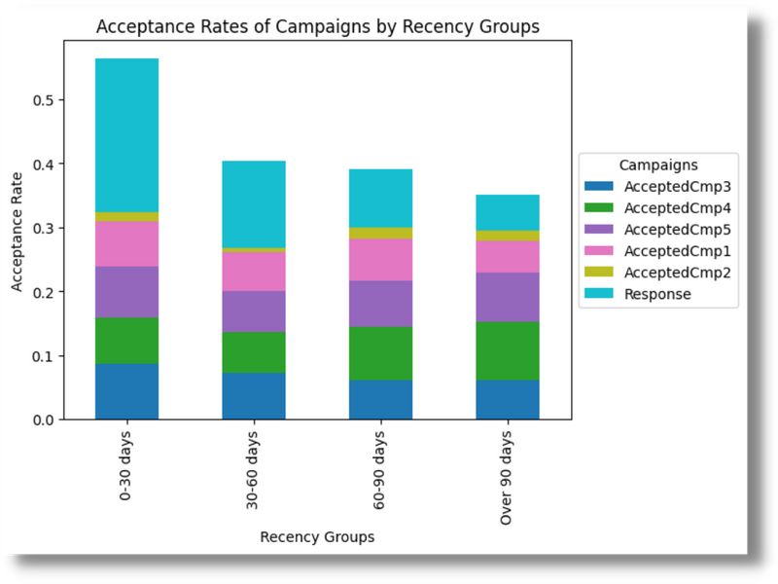
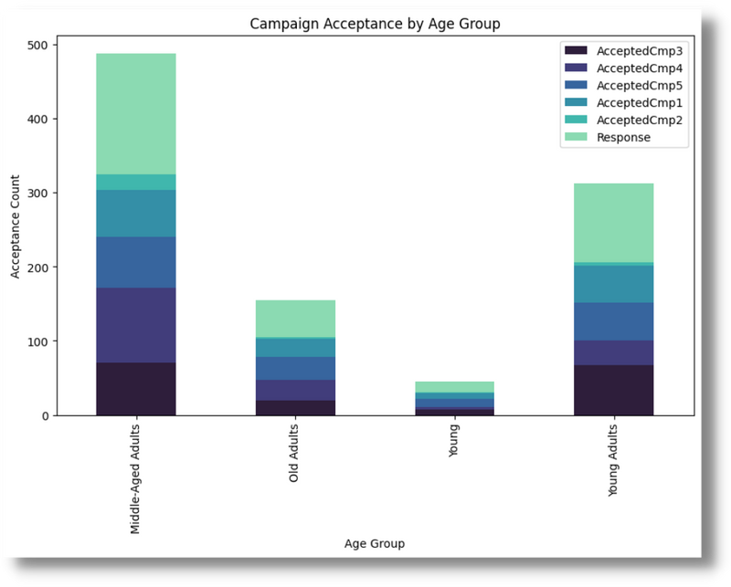

Slide 11
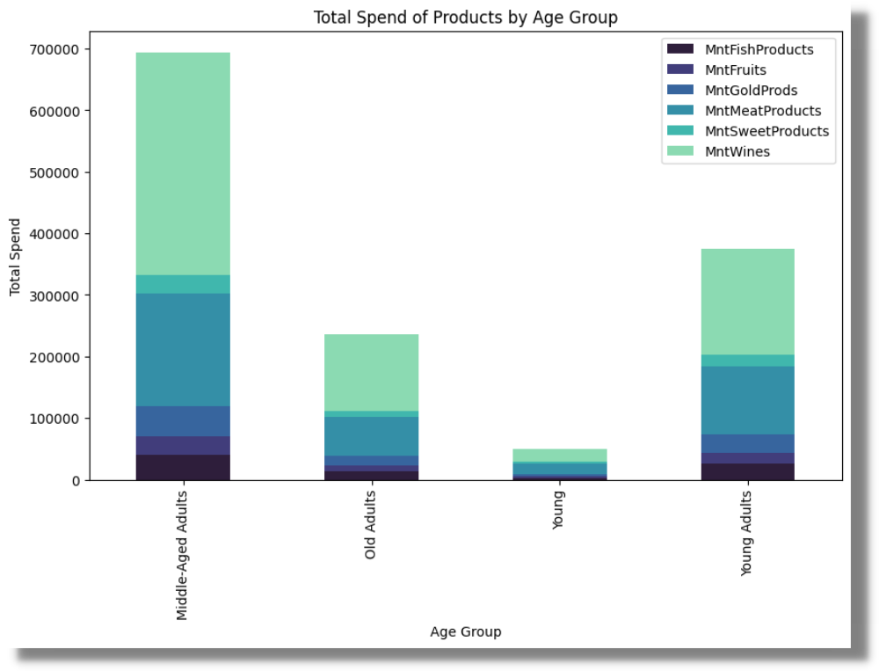
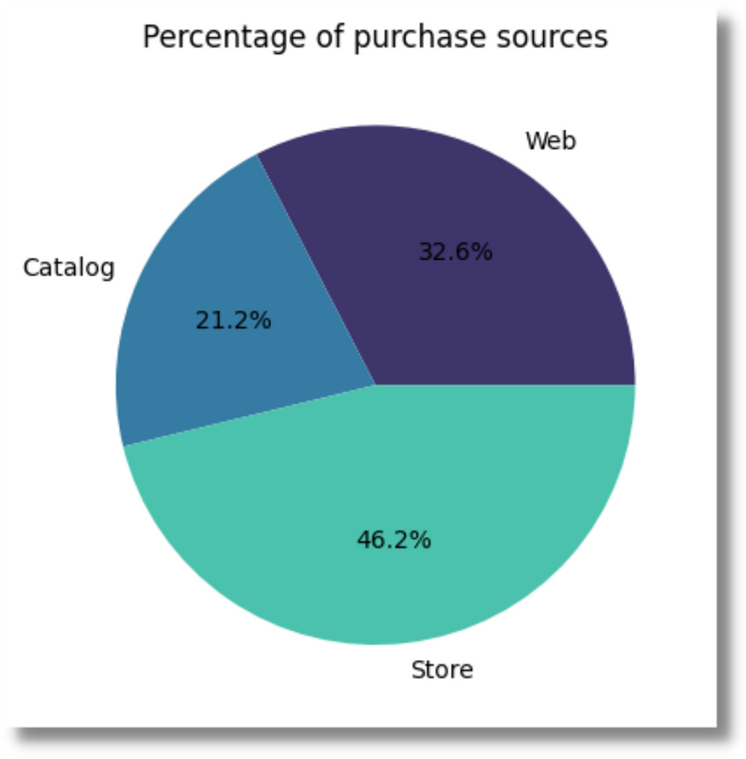

Slide 12
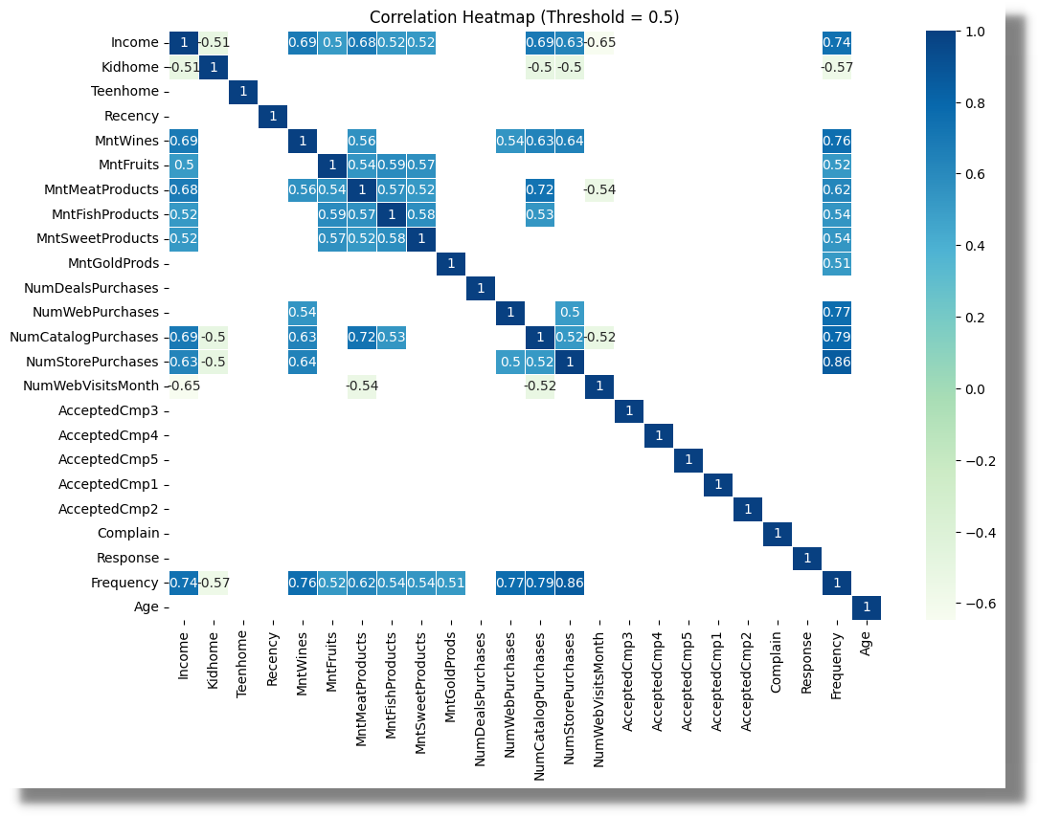

Slide 13
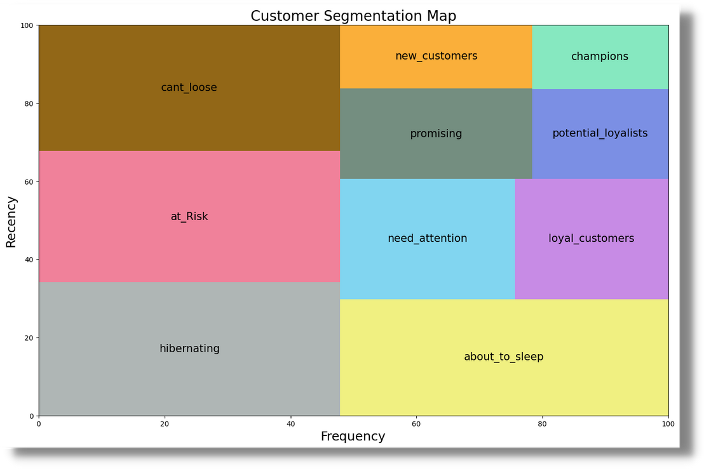
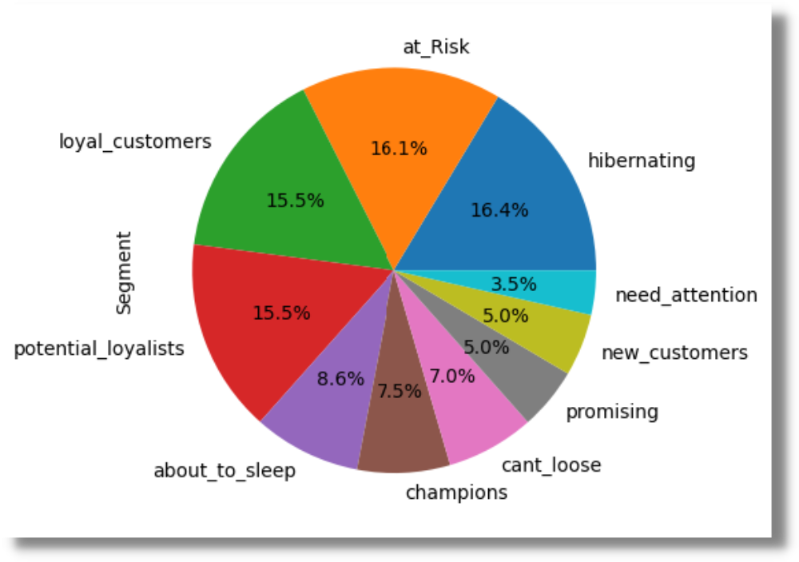
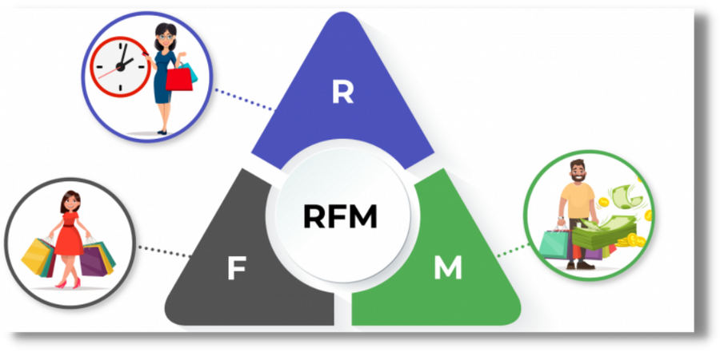

RFM Analysis

Slide 14
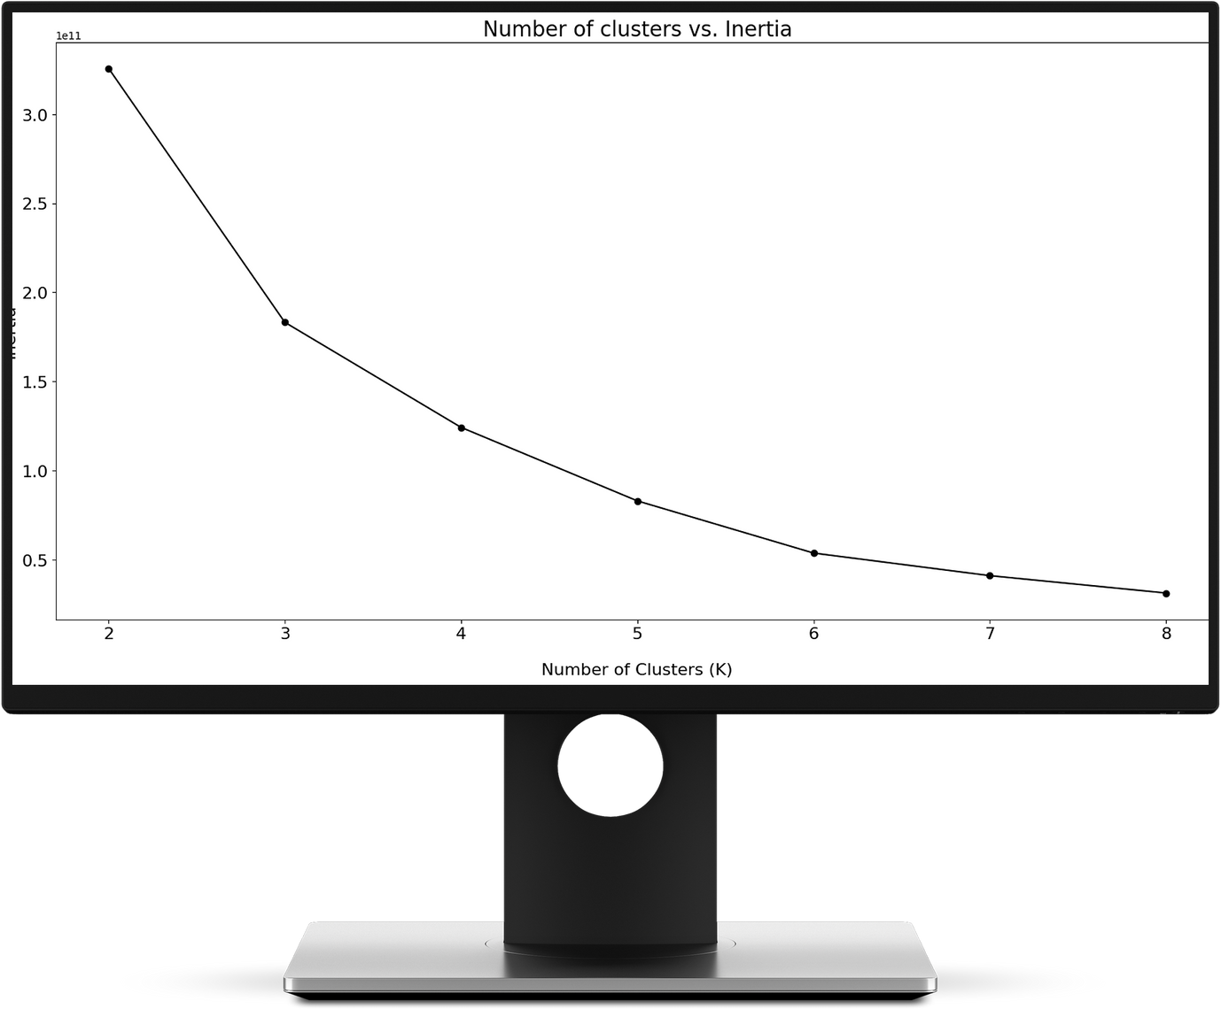


Machine Learning

Slide 15
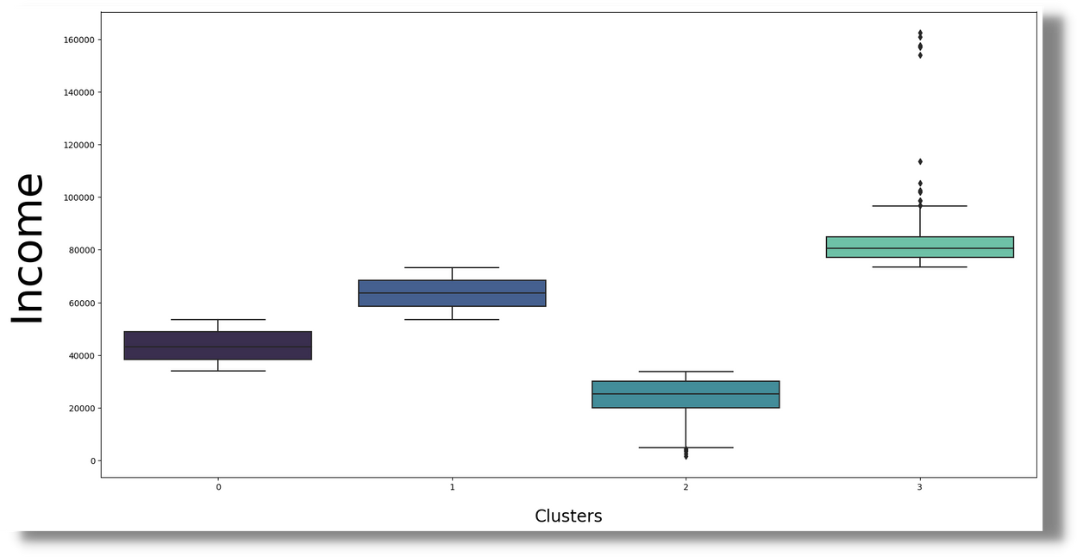
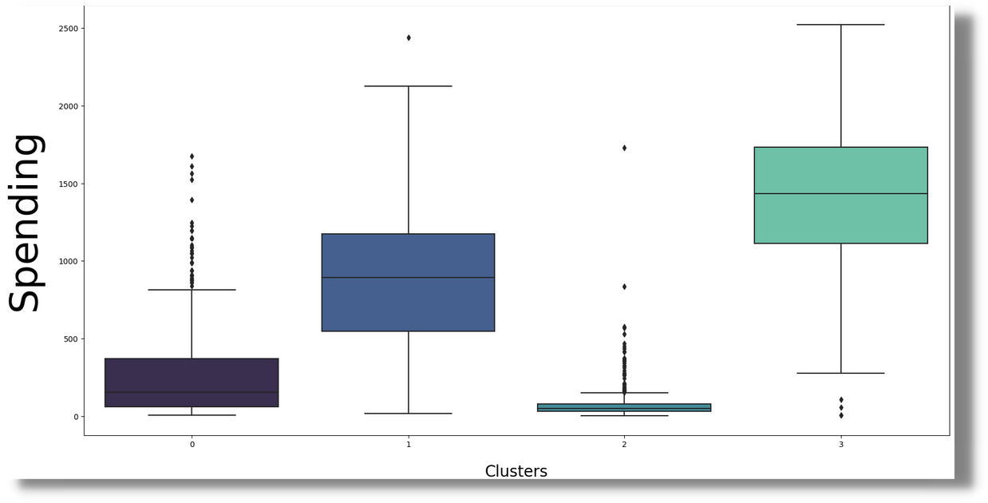

Slide 16
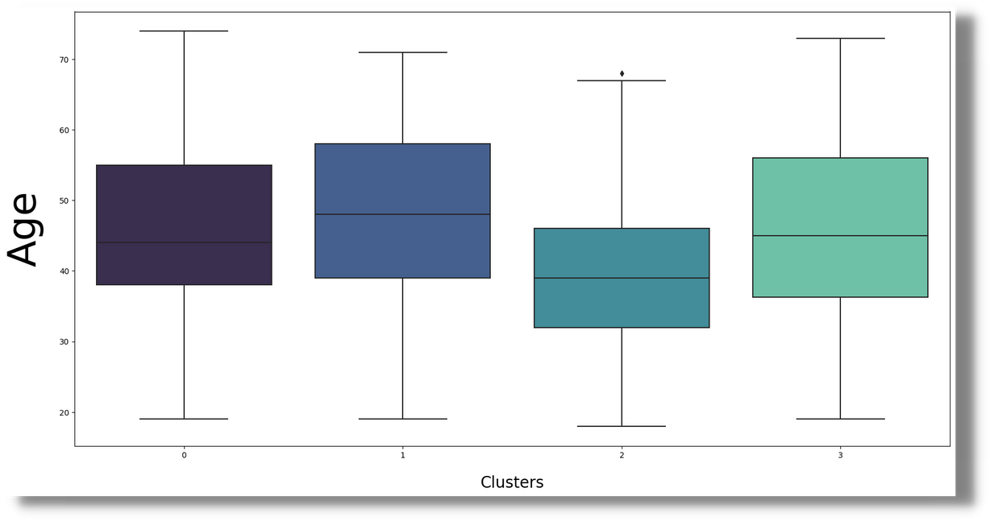
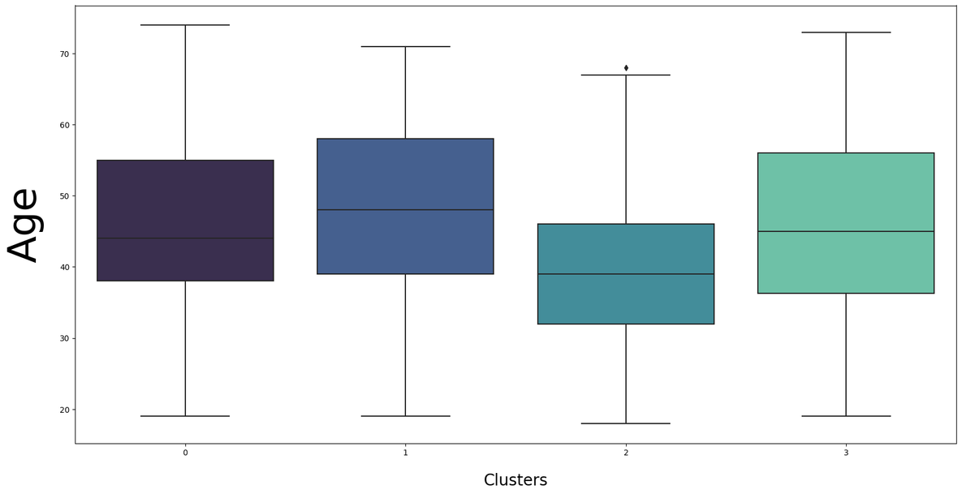
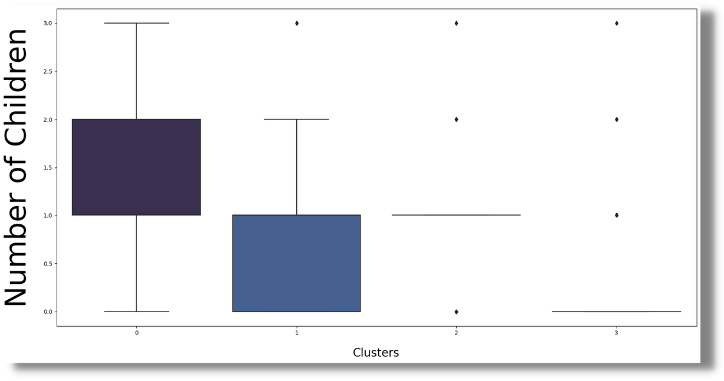

Slide 17
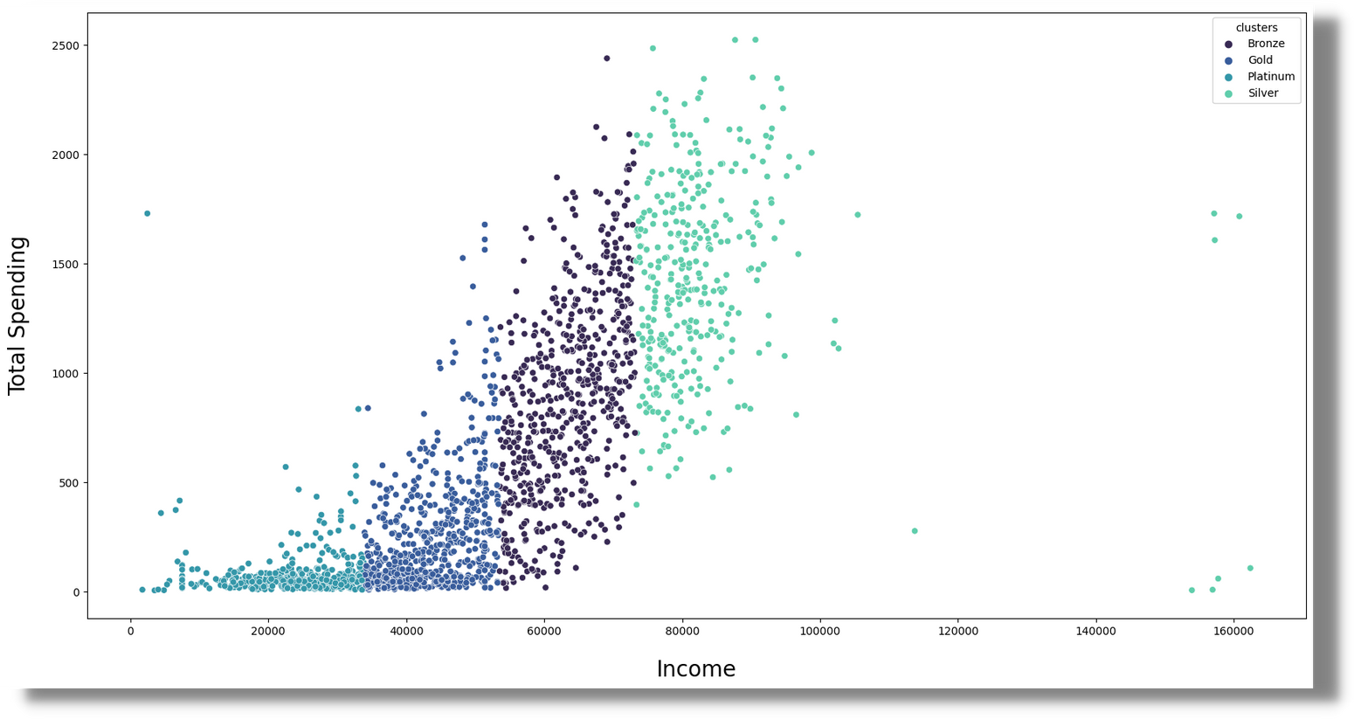
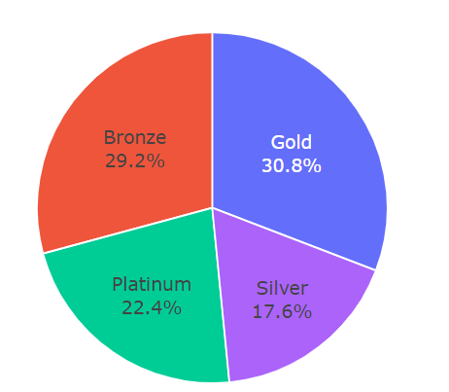

Slide 18
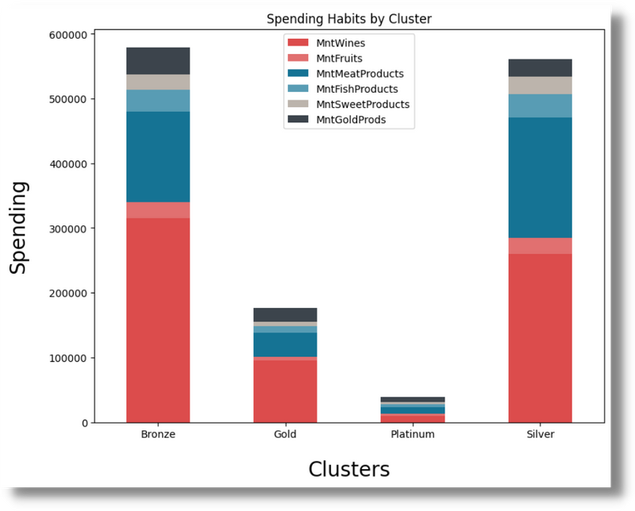
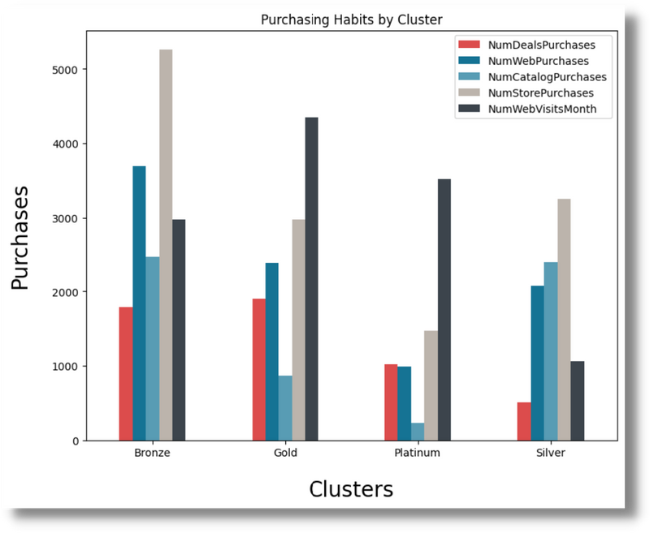
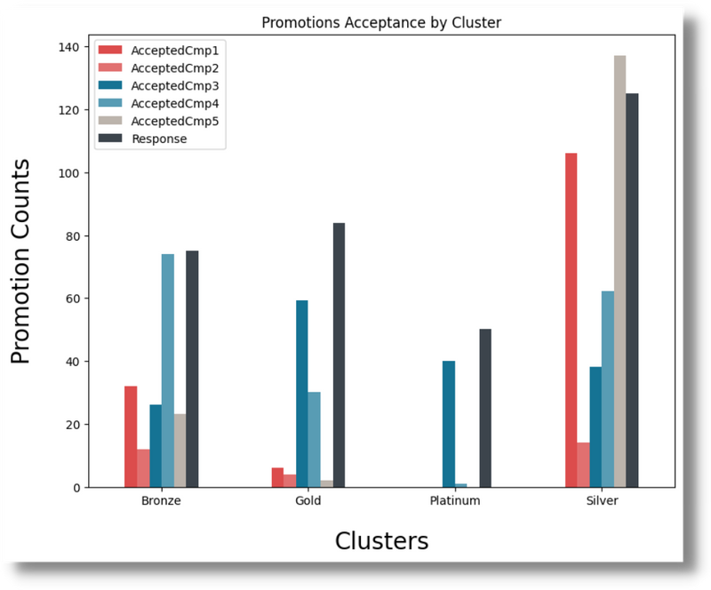

Slide 19


Thank you for your attention!

